Slide 1
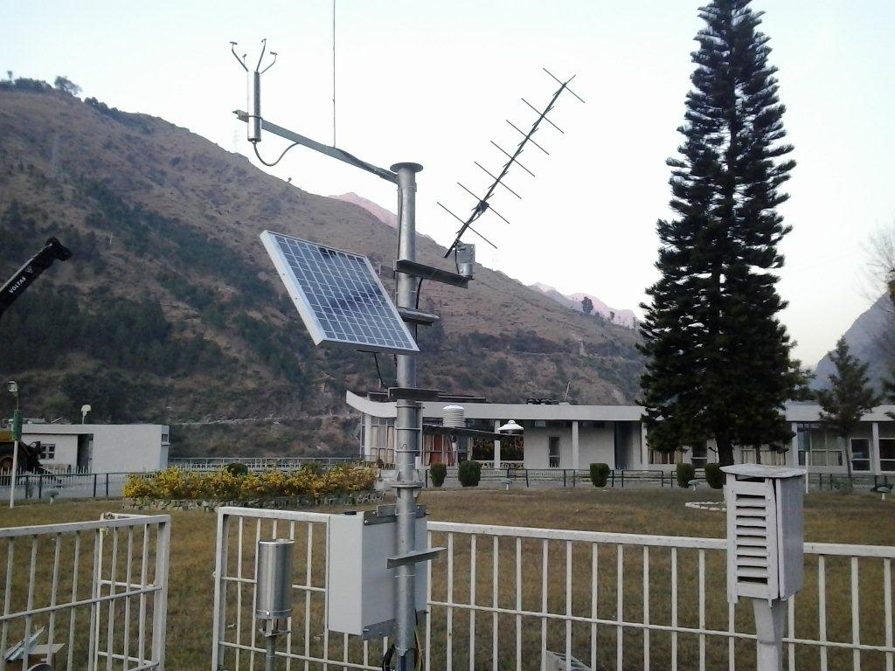
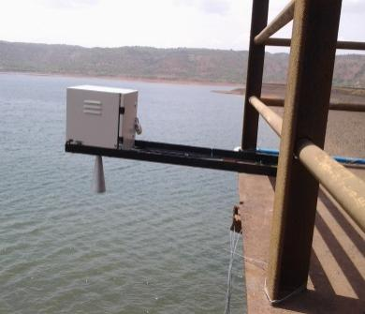
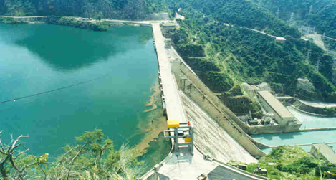
World Bank Group
Support for IWRM in India
William Young
Lead Water Resources Management Specialist
New Delhi

Slide 2
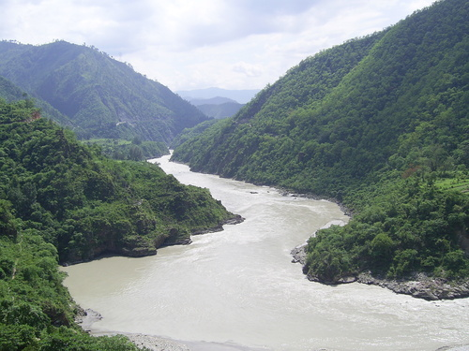
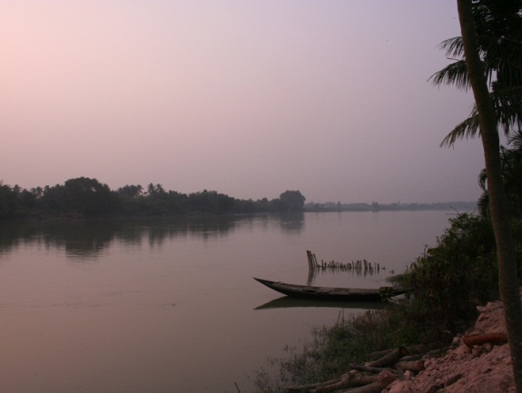
Presentation outline
Introduction
  Key water resources issues in India
  The IWRM Challenge
WBG Portfolio
  Size, scope, geography, progress
Future directions
  Changing needs and opportunities

Slide 3
India’s Water Resources
Increasing relative water scarcity
  4% of the world’s renewable water resource
  2% of the global land mass
  but 17% of the global population
  per capita water availability of global average
  Ranked 50th in the world
High Climate Variability – seasonal and inter-annual
  80% precipitation June– September
High spatial variability
  Influence of Himalaya on the monsoon

Slide 4
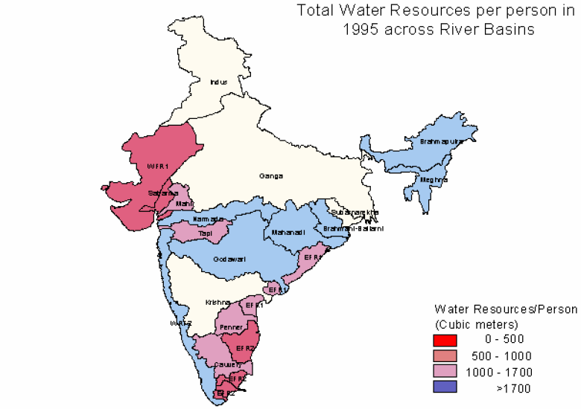
Water Availability by Basin (1995)
Basin | SW Resource (BCM)
Indus | 73
Ganga | 525
Brahmaputra/Barak | 585
Godavari | 110
Krishna | 78
Mahanadi | 67
Narmada | 46
Brahmani/Baitarni | 28
Cauvery | 21
Others | 336
TOTAL | 1869

Slide 5
Water Resources Issues in India
Water critical for livelihoods (water supply, sanitation, food security)
  90% of use is for irrigation – primarily for subsistence agriculture
  2/3 irrigation is groundwater pumping – energy nexus
  Water use efficiency and productivity generally very low
  Huge water supply and sanitation needs – major health and livelihood consequences
Also critical to economic growth in many sector (cities, industry)
  Increased water demand projected for all sectors, esp cities and industry
  Large undeveloped hydropower potential to address energy security: but high sediment load challenge
  Re-allocation challenge is growing
Increasingly stressed water resource base
  Rivers severely polluted and over-abstraction in lean season common
  GW systems polluted and depleted
Notes:
India’s dams capacity = 200 m3 per capita; MICs like South Africa, Mexico, Morocco and China about 1000m3 per capita; USA and Australia about 5000 m3 per capita. India can store about 30 days rainfall, compared to 900 days in major river basins in arid areas of developed countries.
India: 80% domestic water supply from groundwater; more that 20 million tubewells which collectively account for 50% of irrigated area; industry heavy user of groundwater.
15% of India’s food produced using mined, non-renewable ground water
India, National Commission on Water (1999): overall water balances precarious; crisis situations in a number of basins; by 2050 demand exceeds all available sources of supply; 15% aquifers in critical conditions; over next 25 years, 60% aquifers fall into critical condition, unless remedial steps taken.

Slide 6
~55 Mha under irrigation (of ~140 Mha in agriculture)
Agriculture is 16% of GDP; 10% of export income; ~50% of labor force

Slide 7
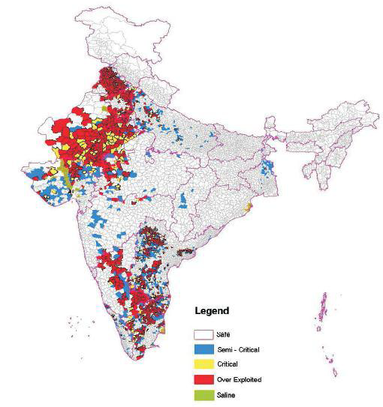
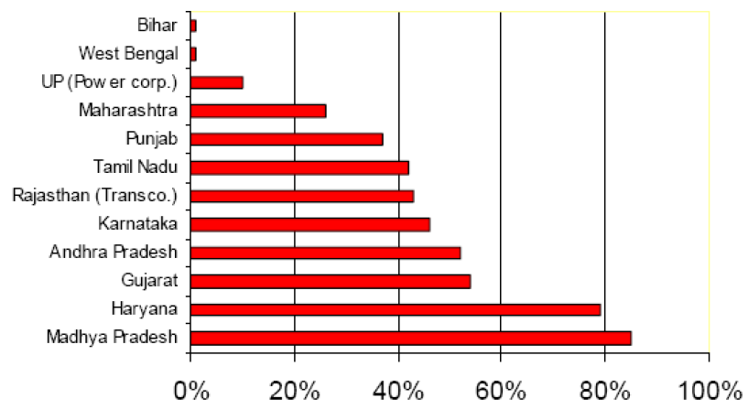
GW Use
15% of India’s food production relies on GW “mining”
Power subsidies by state

Slide 8
Water Resources Issues in India (2)
Very low levels of water storage by world standards
Frequent floods impose a high economic and social costs
  Climate change expected to increase flood extremes
Trans-boundary management a particular challenge
  1/3 of water in international basins, remainder mostly in multi-state basins
  History of tensions and conflicts between jurisdictions
Huge irrigation development, rehabilitation and management needs to meet growing food security concerns
Huge dam safety challenge
Cooperative and river basin planning and management approaches needed to address growing challenges
If WRM challenges are unmet, water will increasingly be a limiting factor to growth and poverty reduction and source of conflict

Slide 9
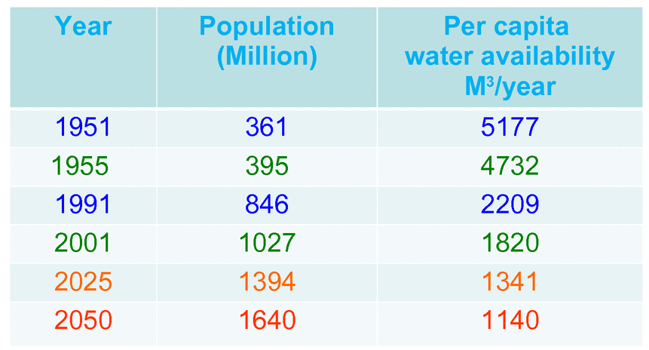
Increasing relative scarcity

Slide 10
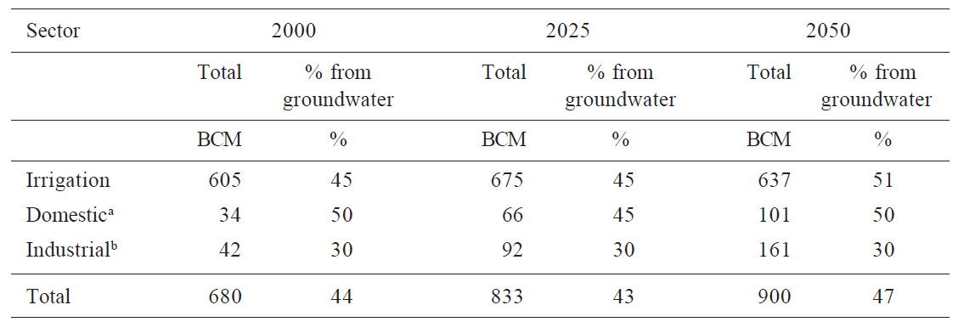
Water Demand Projections (from IWMI)
Total increase by 2050: 220 BCM, 32%
Contributions to increase
  Irrigation 32 BCM, 15%
  Domestic 65 BCM, 30%
  Industrial 119 BCM, 55%

Slide 11
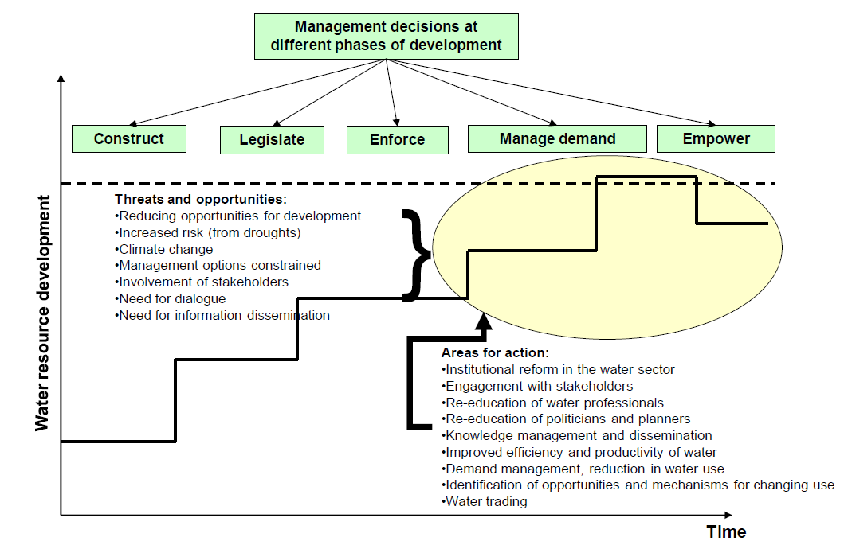

Slide 12
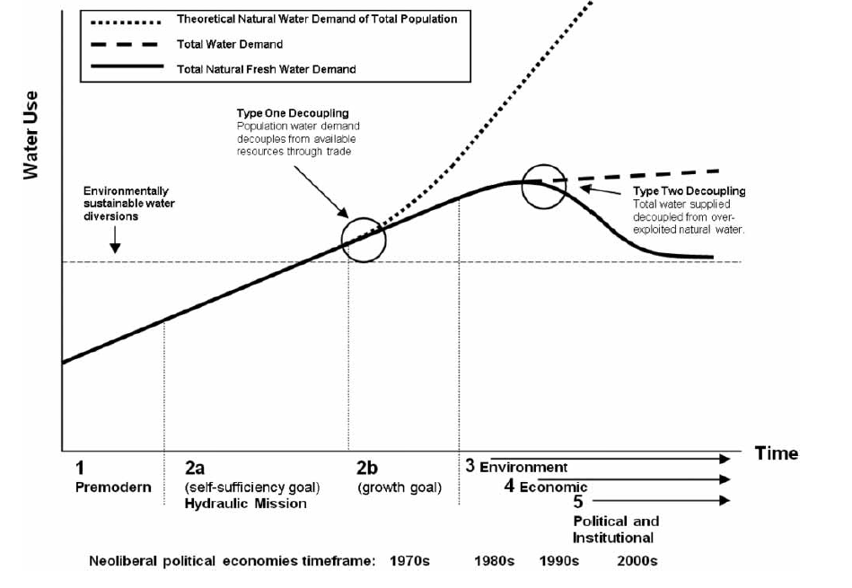
Decoupling growth from increased water use
Gilmont 2014

Slide 13
IWRM Challenges in India
National Water Policy (2012) embraces IWRM but implementation is limited
Integrated management framework that facilitates cross-sectoral planning, development and management across competing uses is needed
Legal and regulatory frameworks require updating
  ill-defined rights/entitlements, unclear/ineffective incentives and allocation
Water institutions need to be established and strengthened
  coordinate split mandates
  build multi-disciplinary technical & policy capacity
  facilitate participation by communities, NGOs and private sector
  change focus from building to maintenance; from development to mgt
  overcome vested interests and perverse subsidies
Multi-lateral and multi-state basin management mechanisms required to address major regional/transboundary water management challenges
Single and multipurpose water development priorities need to be planned and developed in an integrated, equitable and sustainable manner
Notes:
By 2020, economy of Tamil Nadu will be 20% larger if flexible water allocation system, instead of current rigid procedures, was adopted.

Slide 14
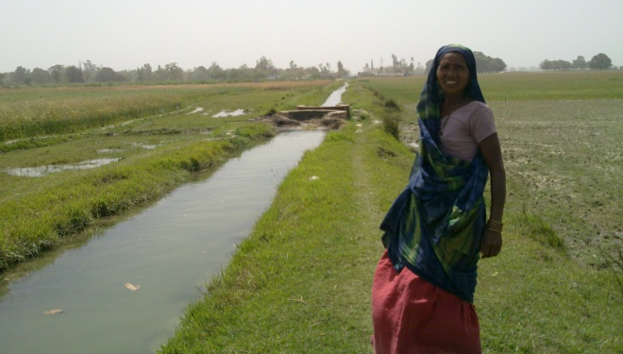
Irrigated Agriculture
Significant irrigation system efficiencies
  irrigated area less than command area
  deteriorating infrastructure due to deferred maintenance
  low water use efficiency and productivity
Local participation and accountability in WRM needs enhancing
  WUAs weak
  water charges not related to service/need and poor collection
On-farm level weakness
  poor water management training or uptake efficient water-use technologies
Over abstraction impacting downstream uses, including the environment
Irrigation is and will remain key to India’s food security
  but agriculture needs to increase water-use efficiency and release water for competing uses

Slide 15
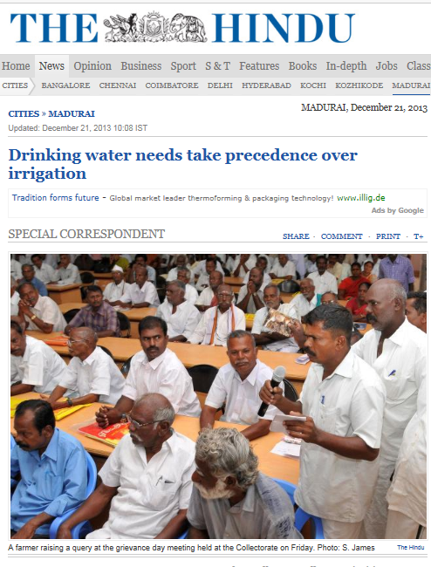
Water Supply and Sanitation
Huge unmet needs in WSS; MDG sanitation target will not be met
  99 million without access to improved drinking water
  931 million without piped water on premises
  807 million without improved sanitation
  620 million practice open defecation
Major Challenge: improving WSS with efficient and sustainable services
Prioritizing drinking water supply over irrigation

Slide 16
Water and Energy
India is energy-deficient and fossil-fuel dependent
  300 million (~25% of India’s population) lack access to power
  700 GW of additional generating capacity required by 2050
India ranks 5th globally in hydropower potential ~150 GW
  Majority (>80%) is in the transboundary basins
  Indus 34 GW, Ganga 21 GW, Brahmaputra 66 GW
Current installed capacity is 37 GW, 25% of economic potential
  Indus 20%, Ganga 25%, Brahmaputra 2%
Development requires cross-border cooperation and integrated basin planning
GW-energy nexus
  Subsidized power for irrigation contributing to depleting GW levels
  Losses from power inefficiencies & subsidies: $23 B (>1% of GDP) in 2011
HEP is ~12% of electricity production
GW pumping (150 BCM) is ~20% of electricity use
  only 30% efficient

Slide 17
Water and the environment
  Major environmental degradation due to water resources development/use and land degradation
  Imposes high socioeconomic and ecological costs
  Major livelihood consequences: subsistence fisheries and agriculture and community WSS
  Water-related diseases in India are 70% of the total disease burden and national loss estimated to be circa 4% of GDP
  Water pollution in India kills over 1 M including ~0.5 M children per year
The Ganges is one of the most polluted rivers in the world
  Environmental, social/cultural and religious values
  Ganga rejuvenation is a high priority for the GOI
Many water ecosystems with international conservation status,
  But inadequate effort and limited capacity to manage these
  Responsibility not with water agencies
No clear policy, legal requirements, procedures or guidelines for establishing environmental flows
  Environmental flows practice has largely focused on hydropower
  Implementation has been ad hoc and a basin approach is lacking

Slide 18
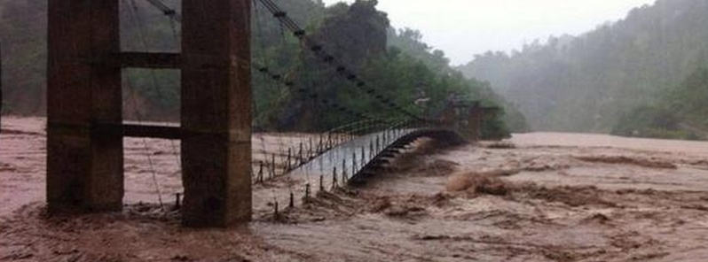
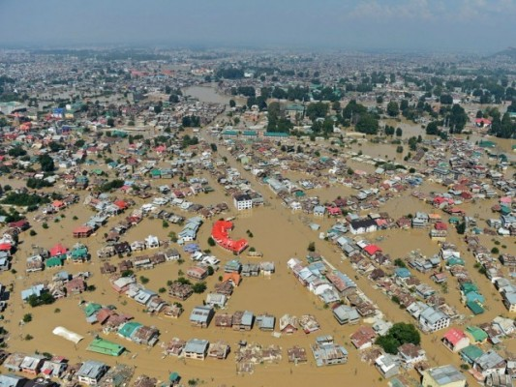
Water-Related Disasters
India highly vulnerable with little institutional capacity to plan, adapt and mitigate
  Increased incidences & cost of flooding ($1B, INR6000 crore/yr)
  Recent devastation in Uttarakhand (death toll over 5000) & recent monsoons in Pakistan
IPCC 5 predicts increases in temp and rainfall variability, but..
  Weak capacity for flood assessment, warning & response
  Weak institutions; agenda fragmented across multiple agencies
  Lack of transboundary cooperation
  Approach stresses rehab and repair not preparedness &resilience

Slide 19
WBG Water Resources Lending Portfolio (US$3B)
Project | Duration | Age | Amount
Orissa Community Tank Management | 8 | 6.3 | $67M
AP Community Tank Management | 9 | 7.7 | $174M
Dam Rehabilitation | 8 | 4.5 | $279M
WB Accelerated Development of Minor Irrigation | 6 | 3.2 | $250M
MP Water Sector Restructuring | 11 | 10.3 | $387M
UP Water Sector Restructuring | 7 | 1.3 | $360M
AP Water Sector Improvement | 6 | 4.6 | $450M
National Ganga River Basin Project | 8 | 3.6 | $1,000M
AVERAGE/TOTAL | 7.9 | 5.2 | ~$3,000M
India Water Resources Management (Hydrology 3) | In prep |  | $370M
Hydrology Project III under preparation (USD 370 million)

Slide 20
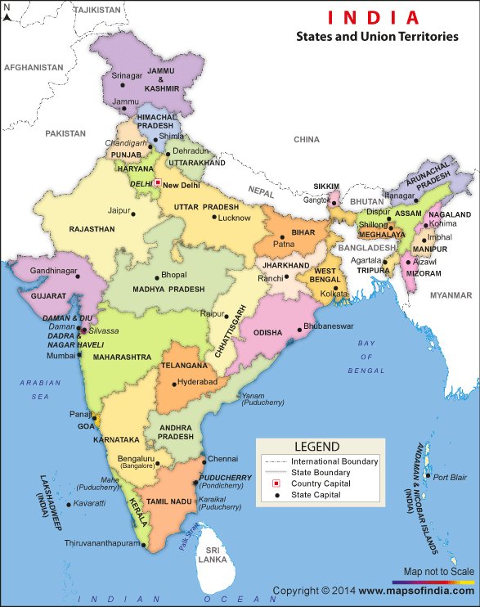
India Water Resources Projects
National Projects
Hydrology Project
Watershed Project
State Projects
DRIP Project (Dams): 4
Tank /Irrigation: 4
Water Sector Restructuring Project: 3
Watershed/Agriculture: 3

Slide 21
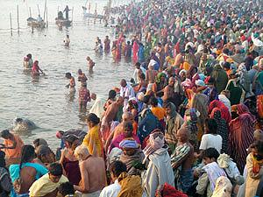
National Ganga River Basin Project
Objectives
  build capacity of NGRBA’s nascent operational-level institutions at both the central and the state levels, so they can manage the long-term Ganga clean-up and conservation program
  implement diverse investments for reducing point-source pollution in a sustainable manner
Institutional Development ($200 Million)
  Support to NMCG & SPMGs
  Ganga Knowledge Center
  Upgrading WQM systems
  Capacity building of ULBs, PCBs
  Communications & outreach
Infrastructure Investments ($1,356 Million)
  Framework approach
  Four sectors: Wastewater Industrial pollution Solid waste management; River front development

Slide 22
NGRBA – Lessons Learnt
A prioritization plan is urgently needed
  Limited resources have been allocated across five States using common sense but not evidence based decision making, and no exclusive focus on “hot spots”
The central government cannot subsidize ad infinitum
  Clean-up is expensive. Traditional wastewater conveyance systems and treatment are expensive. Adding in re-use and re-cycling is expensive. Transaction costs high
  Private sector participation and local state and urban revenue generation are essential; their mobilization however, requires policy reforms
Clean-up cannot be de-coupled from policy making
  PPPs are contingent on revenue streams. Hard to secure private sector investment in absence of better regulation and realistic pricing of water in cities and industries
Urban governance reforms are major missing piece
  GOI can only go so far, and undue reliance on states but limited involvement of ULBs Long-term sustainability at risk despite 10-year DBOs
  Cannot rely on diverting funds from cities or PPPs. Must establish parallel urban reform agenda, including the devolution of functions, finances and functionaries to cities. Dovetail with Smart Cities program?

Slide 23

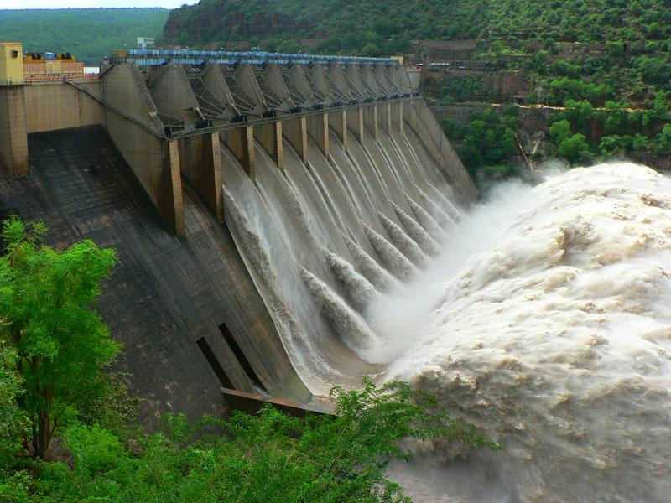
Dam Rehabilitation and Improvement Project
Objective
  improve the safety and operational performance of 261 dams in Tamil Nadu (105), Kerala (53), Karnataka (27), Madhya Pradesh (50) and Odisha (26)
Key components
  Rehabilitation of dams and associated infrastructure
  Dam instrumentation and monitoring; asset management plans and emergency preparedness plans
  Institutional strengthening, focusing on regulatory and technical frameworks for dam safety assurance

Slide 24
DRIP – Issues and Lessons Learnt
Long review process required to check physical status of dams… delayed works implementation
  Hydrology review & dam safety panel review
  Screening template and tender documents
Flexibility required to simplify the review procedure
Communication gaps between central & state govts
  Strengthening required
Lack of maintenance works
  Many rehab works are a results of poor maintenance
  Far greater (including preventative) maintenance required

Slide 25
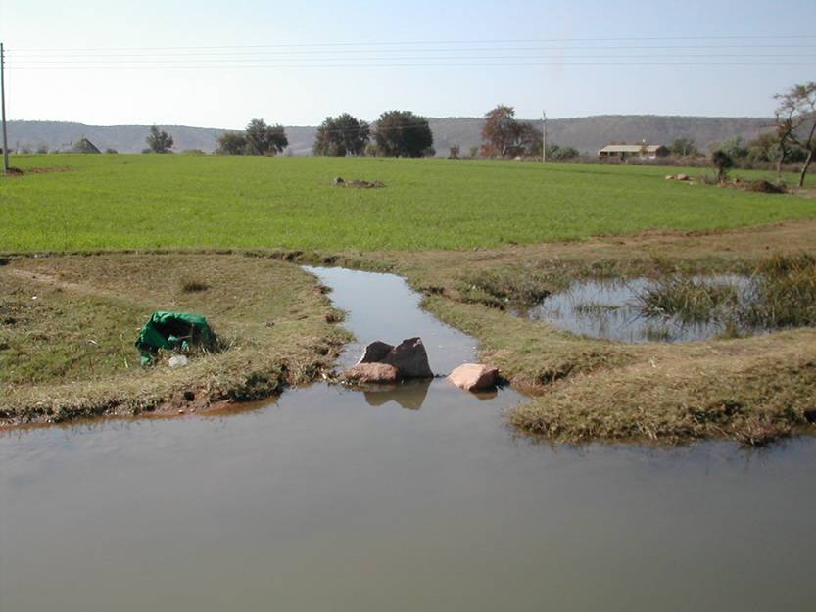
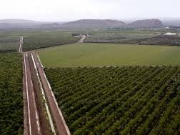
Andhra Pradesh Water Sector Improvement Project
Objectives
  To improve irrigation service delivery on a sustainable basis so as to increase productivity of irrigated agriculture in Nagarjuna Sagar Scheme
  To strengthen institutional capacity for multi-sectoral planning, development and management of water resources
Components
  A: Improving irrigation service delivery and management (US$752M)
  B: Irrigated Agriculture Intensification and Diversification (US$21M)
  C: Institutional Restructuring and Capacity Building (US$23M)
  D: Project management (US$14M)

Slide 26
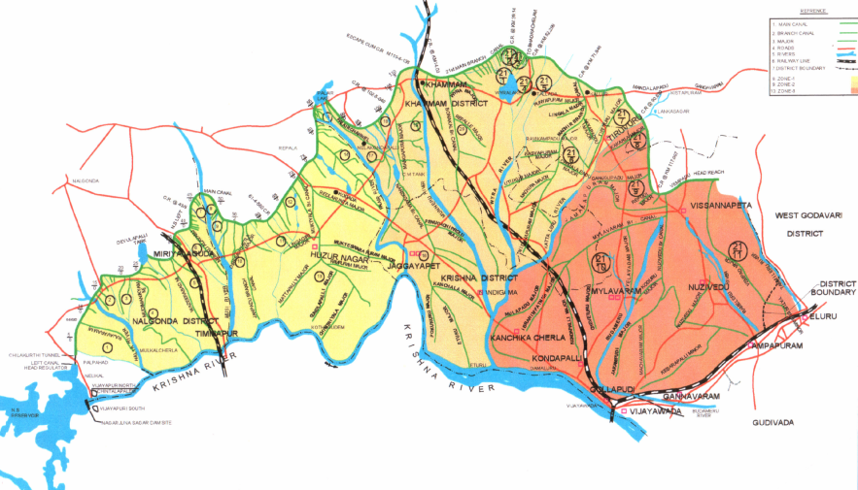
AP WSIP – Issues and Lessons Learnt
Typical dilapidated canal system and poor water management and unsustainable agriculture production system
  Participatory rehabilitation & modernization of canals
  Improved water management practices
  Agriculture diversification
Strengthening of institutional capacity
  Establishing and operationalizing State Water Resources Regulatory Authority
  Restructuring of I&CADD
  Strengthening of WALAMTRI
  Water Users Organizations
  Computerized Information System
Primary & Secondary System Losses =5%
Watercourses Losses = 20%
Outlet Losses = 15%
Field application Losses = 25%
Overall Irrigation efficiency = 35%

Slide 27
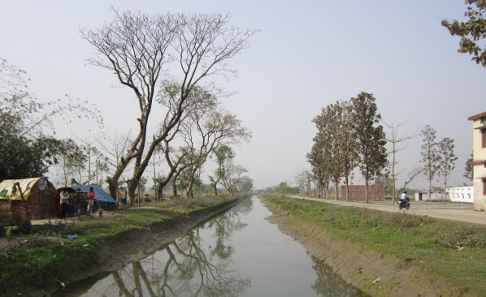
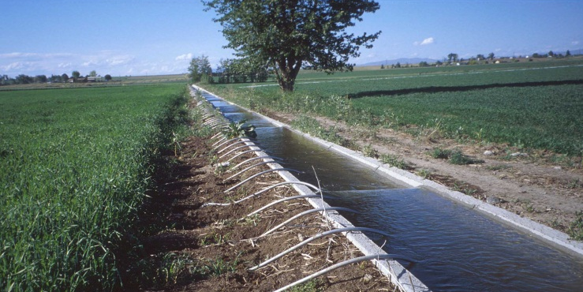
Uttar Pradesh Water Sector Restructuring Project II
Objectives
  Assist the GoUP in strengthening its institutional and policy framework for integrated water resources management for the entire State; and
  Enable farmers in targeted irrigated areas to increase their agricultural productivity and water use efficiency
Components
  A: Strengthening of water institutions and inter-sector coordination ($15M)
  B: Modernization &rehabilitation of irrigation and drainage systems ($326M)
  C: Consolidation and enhancement of irrigation department reforms ($42M)
  D: Enhancing agriculture productivity ($32M):
  E: Feasibility studies and activities for Phase III ($5M):
  F: Project coordination and monitoring ($15M)

Slide 28
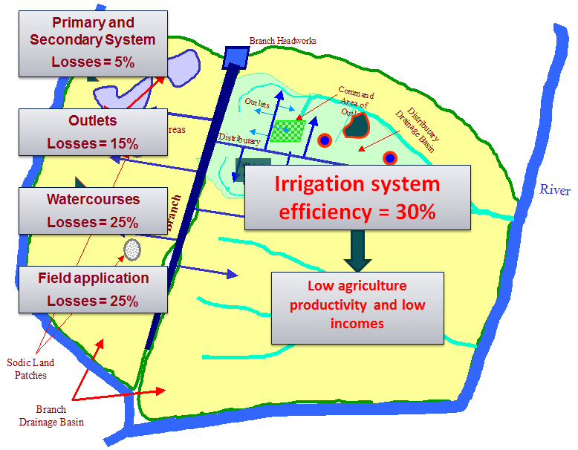
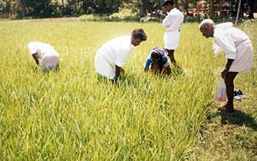
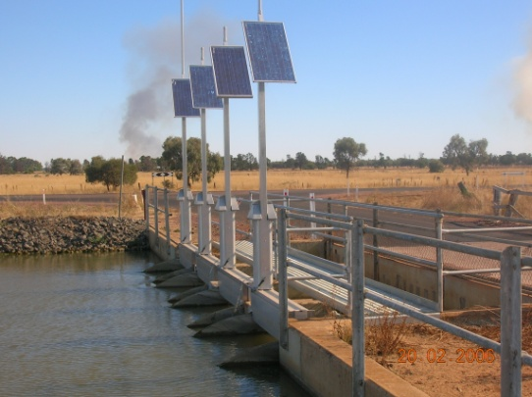
UP WSRP – Issues and Lessons Learnt
Typical low productivity agricultural system
  Modernization and rehabilitation of irrigation and drainage systems
  Participatory rehabilitation & modernization of canals
  Improved water management practices
  Agriculture diversification
Strengthening of water institutions – IWRM knowledge base and analytical capacity
  Integrated water resources information system by State Water Resources Agency
  Strategic river basin assessments and basin planning
  Study on climate change impacts on water resources
  Flood management information system

Slide 29
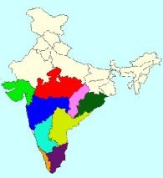
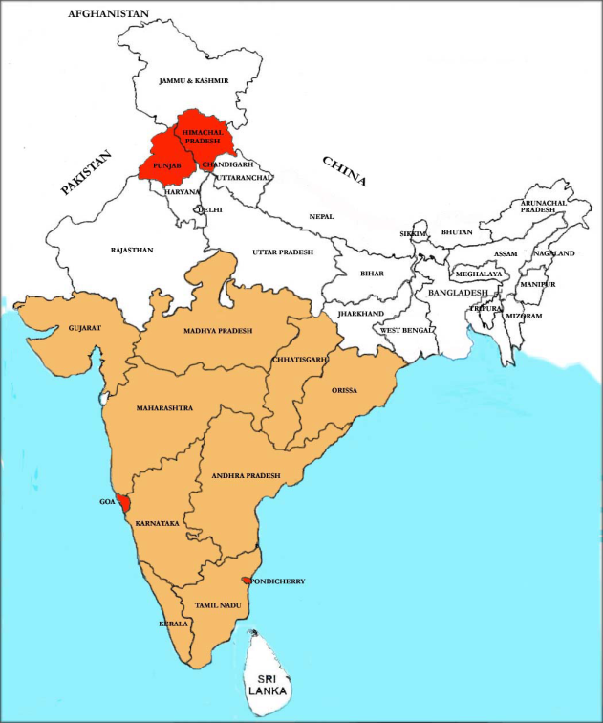
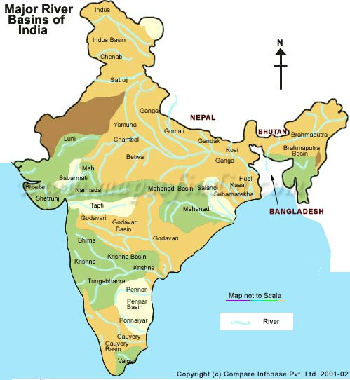
Hydrology Project Evolution
HP-I (1995-2003)
$71M
HP-II (2006-2014)
$105M
National HP-III
(under preparation)
On Going States
New States
9 States
6 Central Agencies
13 States
8 Central Agencies
All Indian States
and UTs

Slide 30
Hydrology Project 3 – $500M, 7 years
Objectives
  To Improve data, information and knowledge systems to strengthen water resources planning, operation and management across India.
Components
  Improving in situ water monitoring system
  Improving water resources information systems
  Water resources management applications
  Strengthening institutions and capacity building
Effectiveness
  Expected for late 2015

Slide 31
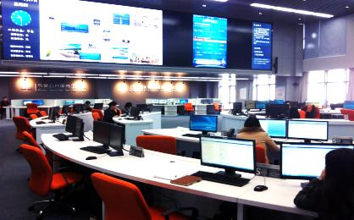
Hydrology Project 3 – Key Issues
National standardization of Water Resources Monitoring and Information System – procedures and database
Enhancing data exchange between Centre & States
Improving access to information in the public-domain
Introducing country-wide generic solutions for flood forecasting and water resources management
Developing site specific solutions for water resources planning, operation and management including use of remote sensing based techniques
Promoting and building institutional and technical capacity river basin planning and management

Slide 32
WRG 2030 – National Activities in India
Knowledge development and unlocking multi-stakeholder collaboration process to support Government of India’s national water related policies (incl. Ganga)
2009-2010
Hydro-economic analysis: Report “Charting Our Water Future”
2011
Working Paper on River Basin Planning & Water Resources Management. (National Water Resources Framework Study for 12th Five Year Plan, Planning Commission, 2011)
2012-2014
Report on collective action for water security & sustainability (with CEEW) – August 2014
International Seminar on Water Risks and Water Stewardship – August 2014
World Economic Forum event – November 2014
Workshops across India triggered Karnataka State level engagement
2015
(proposed)
Ganga Rejuvenation multi-stakeholder platform (2015):
Innovative technologies for waste water treatment and revenue generation
Agri-water efficiency and non-point source pollution – incl. business case for farmers
PPP models for industrial reuse of municipal waste water
Notes:
The 2030 Water Resources Group is an innovative public-private-community platform for collaboration in the water sector. It operates both at the global as well as national and local levels.
The 2030 WRG supports governments in their long-term development and economic growth plans. It was initiated at the World Economic Forum in Davos in 2008, based on the realisation that water forms an imperative for sustainable economic growth (both social and ecological). In fact the latest Global Risk Report of the World Economic Forum (2015) identifies water overuse as the greatest risk for human wellbeing and prosperity.
The 2030 WRG consists of stakeholders from public and private sector, civil society, centers of academic expertise and financing institutions. It acts as an independent entity offering no political, partisan or national nuance to its advice. The aim is to catalyze sustainable water sector transformations and accelerate reforms through fact-based, analytical water security approaches and coalition building.
The 2030 WRG works in accordance with the IWRM definition of Global Water Partnership (TAC, 2000):
“IWRM is a process which promotes the co-ordinated development and management of water, land and related resources, in order to maximise the resultant economic and social welfare in an equitable manner without compromising the sustainability of vital ecosystems.”
The focus of 2030 WRG is particularly on water demand side management: how to improve water use efficiency across sectors to close the water gap?
Its approach is to “ACT” which means that:
Firstly, hydro- and socio-economic ANALYSIS (A) is undertaken to identify the gap between water demand and supply and prioritize solutions based on cost, benefits and risks.
The next step is to CONVENE (C) stakeholders from different backgrounds to design and implement collective public-private-civil society actions.
This results in TRANSFORMATIVE (T) policies, programs or projects to improve water use efficiency at scale.
At national level in India, the 2030 Water Resources Group in 2009 developed a so-called water availability cost curve to close the projected 50% gap in 2030 between water supply and demand. A fundamental part of the solution in India can be achieved through agricultural water productivity measures.
In 2011 the 2030 WRG drafted a working paper about river basin planning and water resources management as part of a research study for the 12th Five Year Plan of the national Planning Commission.
The 2030 WRG will focus its national activities in the coming year on supporting the national Water Resources Ministry in the implementation of its Ganga Rejuvenation Program. Topics currently being addressed through a collective multi-stakeholder approach are:
Demonstration of replicable PPP models for industrial reuse of municipal waste water
Adoption of innovative technologies for more cost-effective municipal sewage treatment – incl. revenue generation
Agri-water efficiency and non-point source pollution – incl. business case for sugar farmers in UP to adopt MIS

Slide 33
WRG 2030 – State Activities in India
Karnataka is 2030 WRG’s earliest State level engagement in India
2030 WRG Maharashtra Agri-Water Partnership was initiated in 2014
2011-2013 – analysis completed:
  Initial phase – focus on diagnostics and project design in agriculture
  Second phase – address water issues in the industrial and urban sectors
Current
  convening multi-stakeholder process: Steering Board under chairmanship of Chief Secretary
Initial work streams for transformation:
  Agricultural Water Use Efficiency: Private Sector Participation in Canal Command Areas
  Wastewater Reuse: Urban and Industrial Sectors
Convening: multi-stakeholder Sounding Board chaired by ACS for Agriculture, GoM
Analysis: preliminary agri-water study completed
Work streams being established:
  Watershed++ model: Public-Private-Community Partnerships for watershed development, agri-water efficiency, productivity increase and market linkages
  Viable technologies & smart financing: for large scale adoption of agri-water saving
  Integrated approach for Aurangabad: collective action for regional water security
Partnership scope is being extended to include irrigation (Canal Command Areas) and urban/industrial water management
Notes:
Karnataka was the first State where the 2030 WRG engaged in 2011. After an extensive analysis phase, the partnership with the Government of Karnataka is now moving into the convening stage under chairmanship of the Chief Secretary of Karnataka. At this moment two work streams are operational:
Agricultural water use efficiency to achieve 100% adoption of MIS in the sugar cane sector with private sector participation from financial institutions and corporates.
Waste water reuse in urban and industrial sectors.
The second State level engagement was initiated in January 2014. The 2030 WRG entered into an agri-water efficiency partnership with the Government of Maharashtra. The initial focus was on rain-fed agriculture. A pre-liminary analysis study has recently been completed under guidance of a multi-stakeholder Sounding Board. Presently three work streams are being established along the following topics:
Watershed++ model: Public-Private-Community Partnerships for watershed development, agri-water efficiency, productivity increase and market linkages
Viable technologies & smart financing: aiming at large scale adoption of agri-water saving technologies
Integrated approach for Aurangabad: collective action for regional water security
The 2030 WRG is currently exploring with the Government of Maharashtra how to extend the scope of the partnership beyond rainfed agriculture to ensure a more integrated drought management approach across the State.

Slide 34
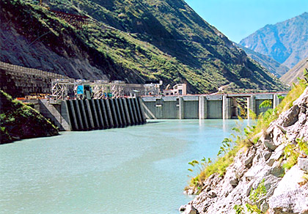
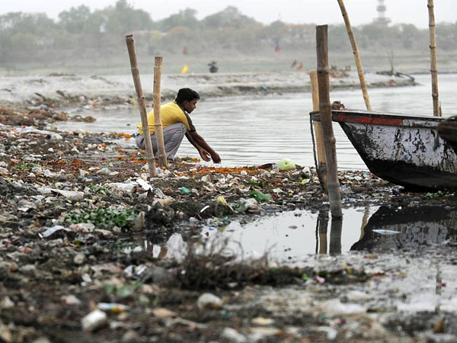
WBG Support for IWRM
Diverse portfolio supporting many aspects of IWRM
Includes infrastructure investments and reforms
State level initiatives that can be extended to other priority states
Critical support into Low Income States
Multi-state program (DRIP)
National hydrology project (HP3)
Includes technical assistance via 2030 WRG

Slide 35
Future Directions
Build the information base to support evidence-based planning and management
Progress legislative reforms to enable empowered RBOs and appropriate water entitlement system
Incentivize water use efficiency in all sectors
Focus government efforts on ensuring social and environment benefits are protected
Continue the shift in focus from new infrastructure to improved management
Shift the infrastructure focus from construction to improved maintenance and management
Shift the flood management focus from protection to improved forecasting and warnings, and floodplain zoning
More effort required to understand regional scale climate change risks to water resources and build system resilience
Institutional reforms that facilitate water user and other stakeholder engagement and that stimulate private sector investment

Slide 36
Thank You
Wyoung@WorldBank.Org

